Slide 1
Multiple-instance Weakly Supervised Object Localization
Thesis – 29/6/2023
Geert Goemaere

Slide 2
Content
Introduction
Research question
Methodology
Experiments
Conclusions
Notes:
Time:
10’ introduction + research method + methodology
10’ experiments + conclusions

Slide 3
Introduction

Slide 4

Multiple-instance WSOL
WSOL
Multiple-instance WSOL
Notes:
The research topic of this thesis is called “multiple-instance weakly supervised object localization” (multiple-instance WSOL).
So, let’s first explain where in the object recognition landscape whe can situate multi-instance WSOL by looking at different tasks in this picture.
Image classification deals with assigning a single label or category) to an image. Here the label is CAT.
Object localization deals with localizing objects in an image by indicating their bounding box. In the case of WSOL, only a single object is localized by training a model with class labels only.
Object detection is the task of locating objects in an image with bounding boxes and assigning a class label for each detection.
Instance segmentation deals with assigning a class label for each pixel of an image.
Just as WSOL, multi-instance WSOL uses only class labels to train a model for localization, but it extends WSOL to find mutiple objects of the same class.

Slide 5
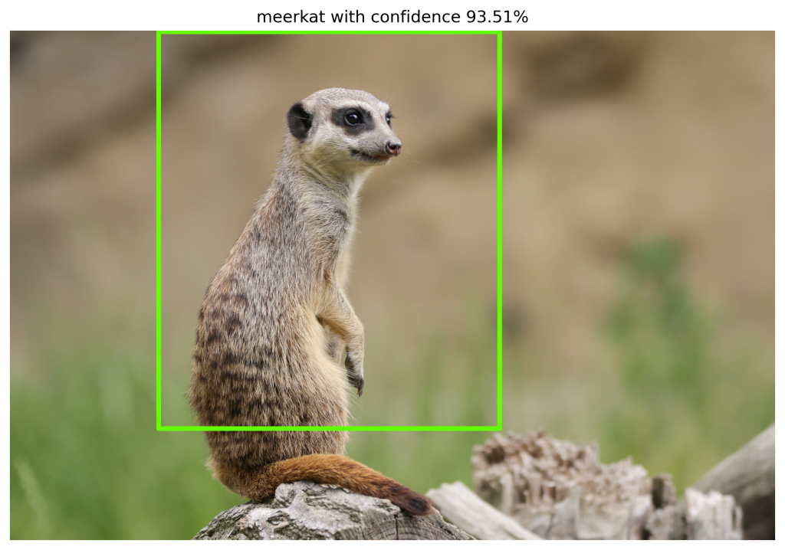
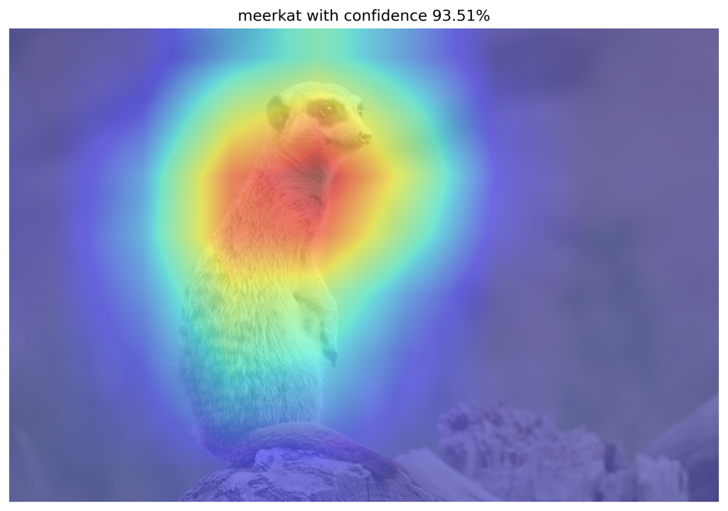
WSOL problem
CAM-based WSOL methods
Class Activation Mapping (CAM)
Localization using discriminative features
Partial object coverage
CAM-based techniques
Grad-CAM, Grad-CAM++, Score-CAM, MinMaxCAM
Problem
Assumption of single image-level class
Multiple-instance localization hasn’t been tested in prior-art

Slide 6
Research question

Slide 7
Research question
Can we use CAM-based methods to evaluate and improve
localization of multiple object instances of the same class
within images for the WSOL task?

Slide 8
Research question - contributions
Can we use CAM-based methods to evaluate and improve
localization of multiple object instances of the same class
within images for the WSOL task?
protocol
Iterative localization
Synthetic dataset

Slide 9
Methodology
Multiple-instance WSOL

Slide 10
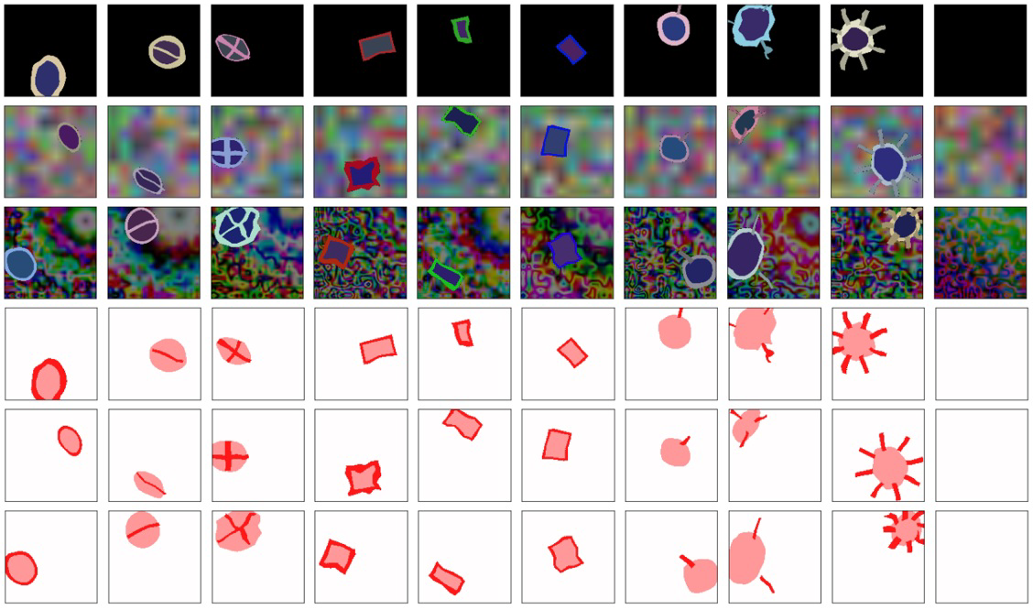
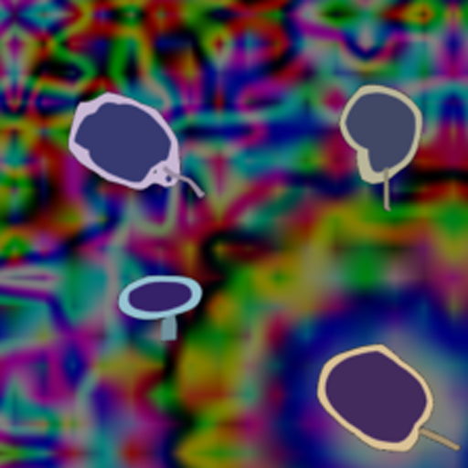
Synthetic datasets
Synthetic dataset [Tjoa, E. et al.]
Single instance, 10 classes
GT: image-level class, segment mask
Multiple-instance datasets
Control over instances, structure, ground truth
Multiple instances, single class
8 datasets: d<1..4><b|t>
d3b: images with 3 object instances on background (b)
d2t: images with 2 object instances on transparent (t) background
GT: image-level class, segment mask (object), bounding boxes

Slide 11
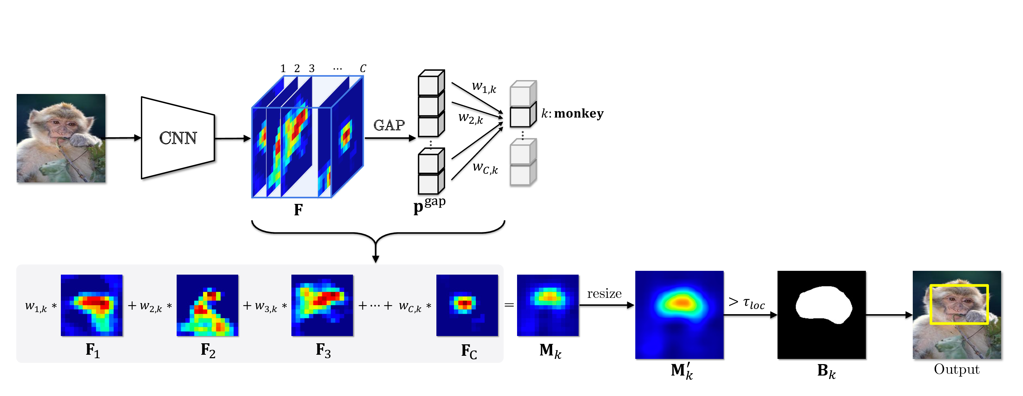
CAM-based WSOL
Classifier is trained using image-level class labels
Activation map = weighted (*) combination of feature maps
Binary mask = Activation map > threshold 𝛕
Predicted bounding boxes are computed from contours in binary mask
(*) Weight computation is specific to CAM-based method

Slide 12
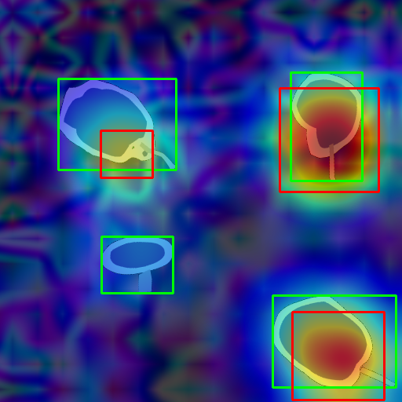
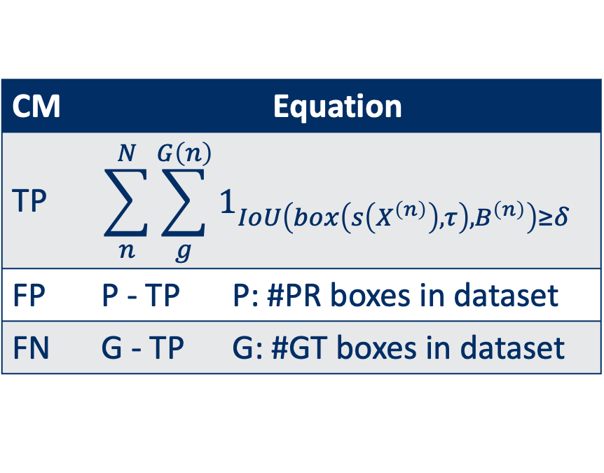
Multiple-instance localization metrics
Problem
No existing multiple-instance localization metrics
GT₁
GT₂
CM | Equation
TP | $$\sum_{n}^{N}{\sum_{g}^{G\left(n\right)}{1_{IoU\left(box\left(s\left(X^{\left(n\right)}\right),τ\right),B^{\left(n\right)}\right)≥δ}}}$$
FP | P - TP | P: #PR boxes in dataset
FN | G - TP | G: #GT boxes in dataset
PR₁
PR₂
GT₃
GT₄
PR₃

Slide 13
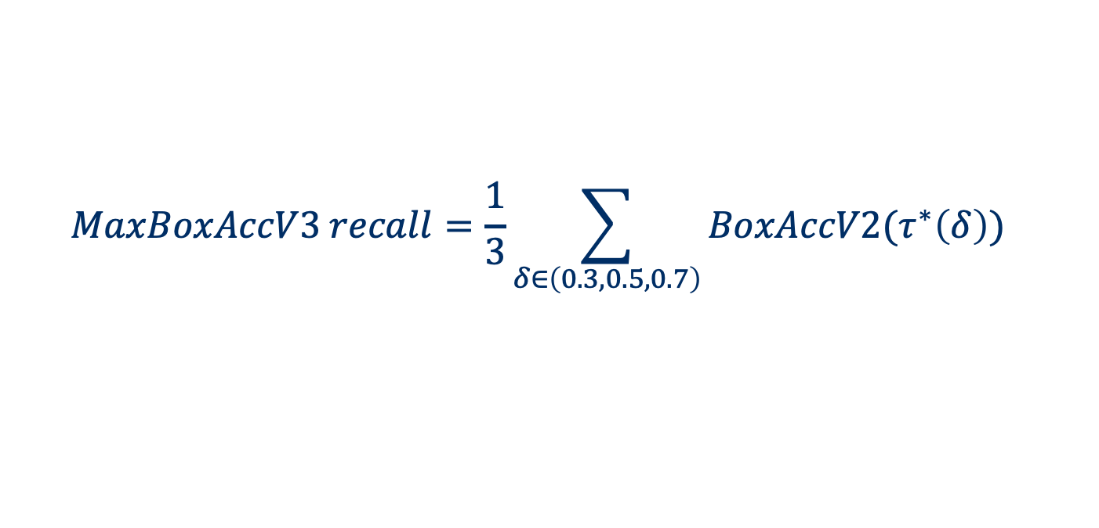
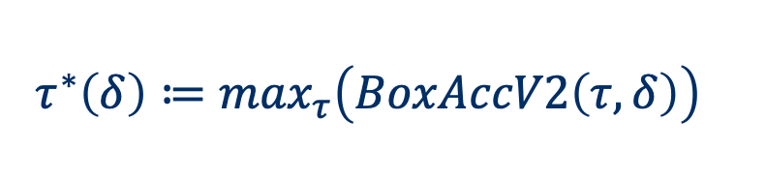
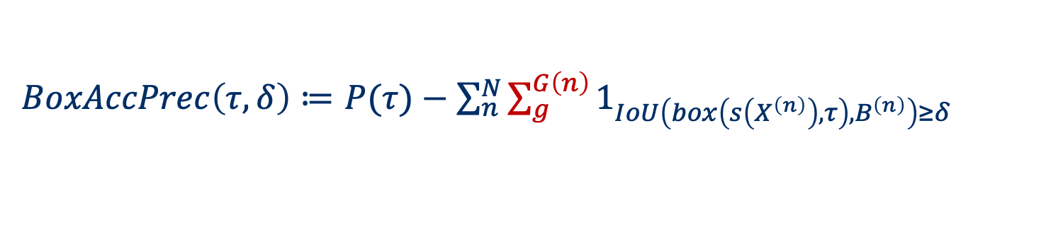
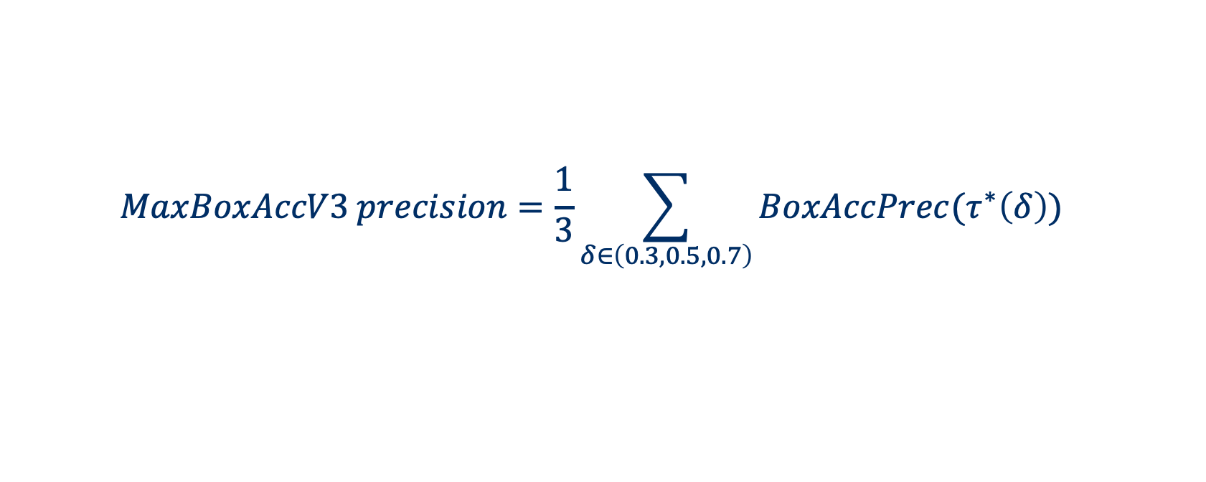
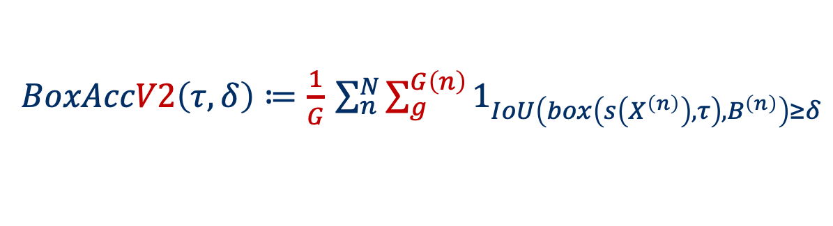
Metrics – MaxBoxAccV3 (derived from Choe et al.)
$BoxAccV2\left(τ,δ\right)≔\frac{1}{G}$ $\sum_{n}^{N}{\sum_{g}^{G\left(n\right)}{1_{IoU\left(box\left(s\left(X^{\left(n\right)}\right),τ\right),B^{\left(n\right)}\right)≥δ}}}$
Recall:
Precision:
Optimal threshold:
$BoxAccPrec\left(τ,δ\right)≔$ $P(τ)−\sum_{n}^{N}{\sum_{g}^{G\left(n\right)}{1_{IoU\left(box\left(s\left(X^{\left(n\right)}\right),τ\right),B^{\left(n\right)}\right)≥δ}}}$
$$τ^{∗}\left(δ\right)≔\max_{τ}\left(BoxAccV2\left(τ,δ\right)\right)$$
$$MaxBoxAccV3 recall=\frac{1}{3}\sum_{δ∈\left(0.3,0.5,0.7\right)}{BoxAccV2(τ^{∗}\left(δ\right))}$$
$$MaxBoxAccV3 precision=\frac{1}{3}\sum_{δ∈\left(0.3,0.5,0.7\right)}{BoxAccPrec(τ^{∗}\left(δ\right))}$$
Notes:
Remark: discuss difference with BoxAcc and why BoxAcc is not applicable for multi-instance localization.

Slide 14
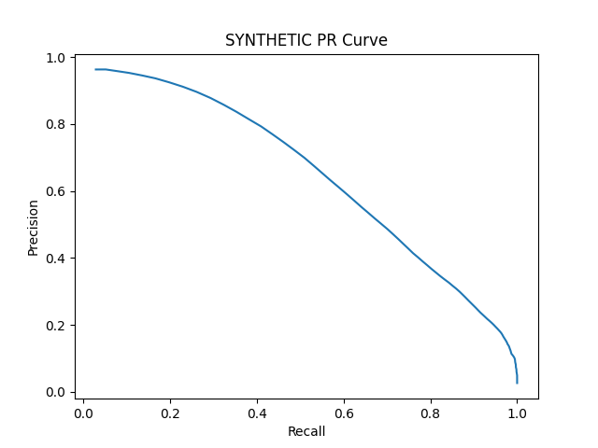
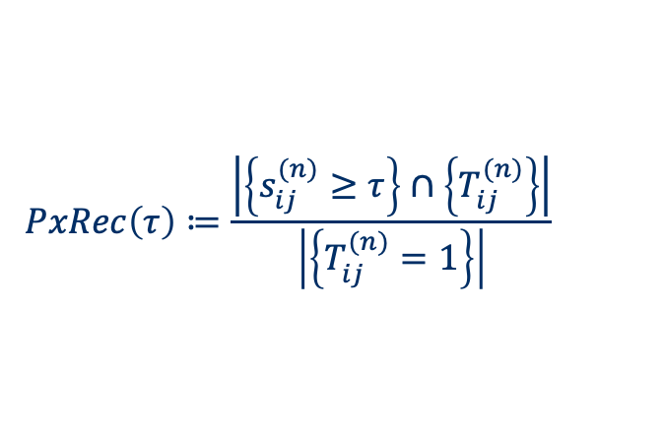
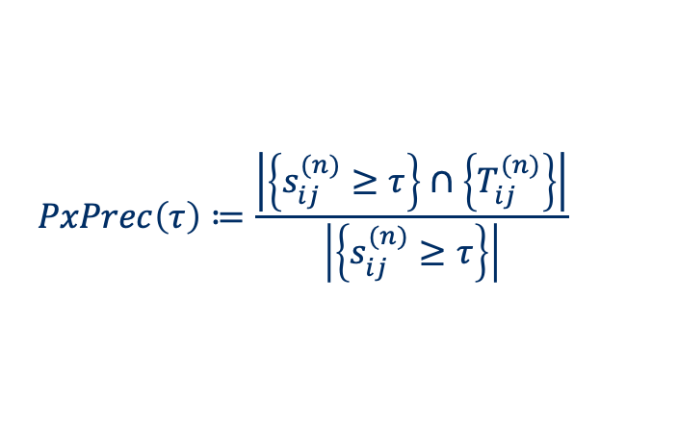
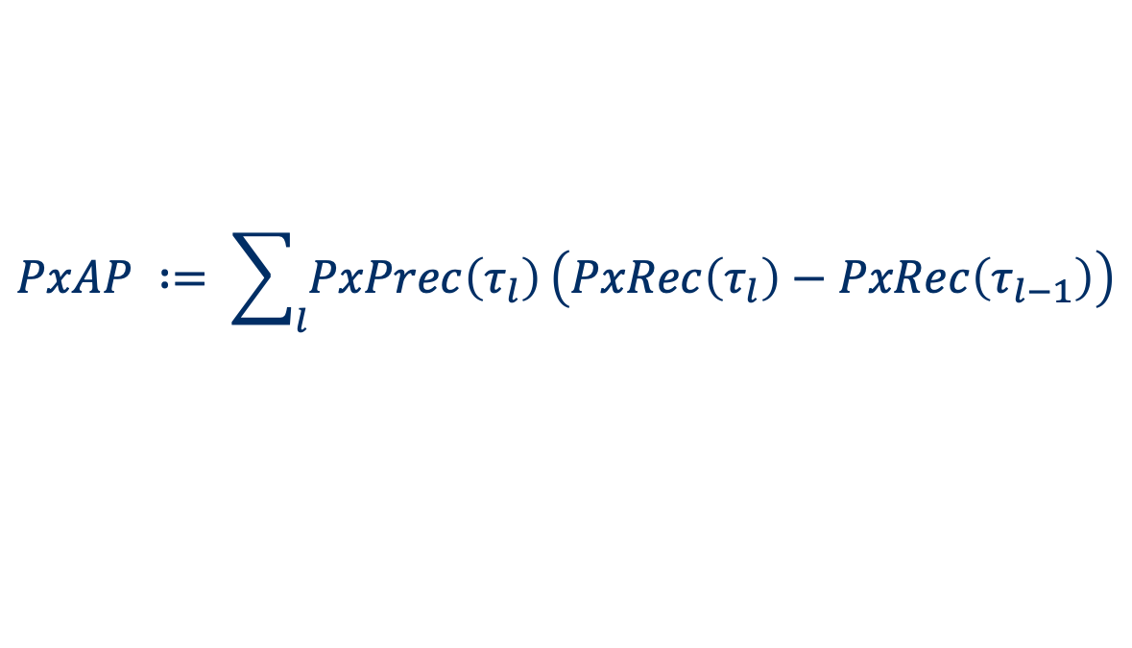
Metrics – Pixel Average Precision (PxAP)
PxAP already used in [Choe et al., 2020b]
Applies to multi-instance localization
Only usable when GT segmentation masks available
$$PxPrec\left(τ\right)≔\frac{\left|\left\{s_{ij}^{(n)}≥τ\right\}\right.∩\left.\left\{T_{ij}^{(n)}\right\}\right|}{\left|\left\{s_{ij}^{(n)}≥τ\right\}\right|}$$
$$PxRec\left(τ\right)≔\frac{\left|\left\{s_{ij}^{(n)}≥τ\right\}\right.∩\left.\left\{T_{ij}^{(n)}\right\}\right|}{\left|\left\{T_{ij}^{(n)}=1\right\}\right|}$$
$$PxAP ∶= \sum_{l}{PxPrec\left(τ_{l}\right)}\left(PxRec\left(τ_{l}\right)−PxRec\left(τ_{l−1}\right)\right)$$
Notes:
Remark: keep as backup slide

Slide 15
Localization improvement
Problem
WSOL task is trained for classification
Network activates on most discriminative features related to target
Not required to activate equally strong on all object instances
Localization of some object instances may be missed
Solution – Iterative localization
Localize object instances in image using CAM-based method
Mask image with localized object instances
Retry until stop criterion is met
Notes:
Remarks:
Toon image waarbij enkel discriminatieve features highlighted zijn.
Visueel aantonen hoe iteratieve localizatie werkt

Slide 16

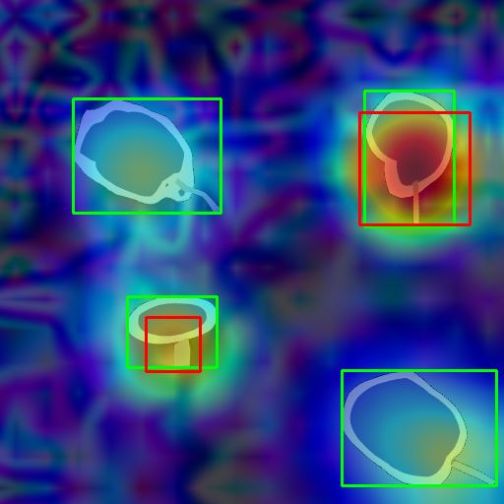
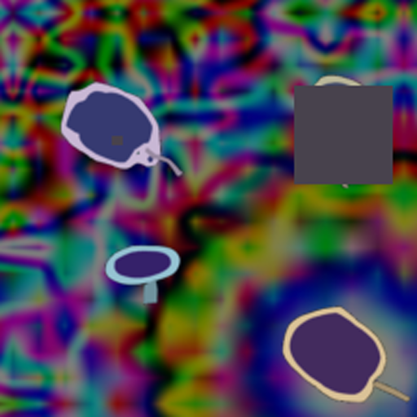
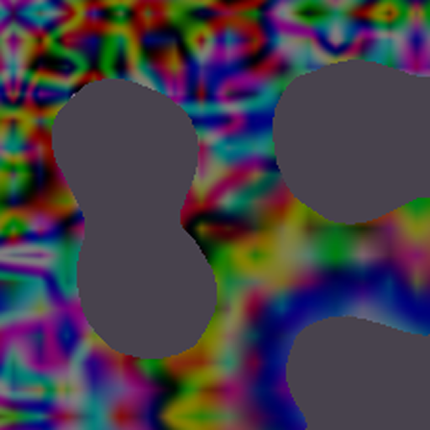
Iterative localization
Oracle based
Score map based

Slide 17
Experiments

Slide 18
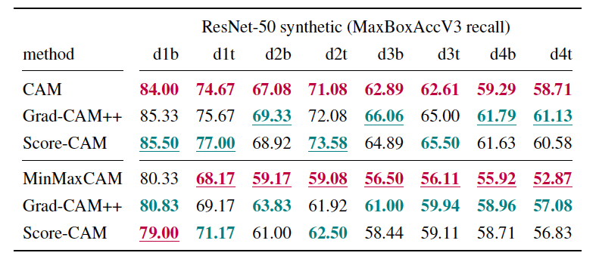
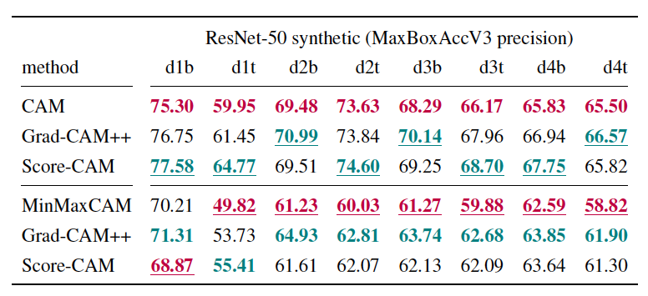
Localization: ResNet-50 - Synthetic datasets
Notes:
Remark:
- Describe trend (red, green results)

Slide 19
Localization: ResNet-50 - Synthetic datasets
Notes:
Remark: qualitatief voorbeeld. Kort bespreken.
2 slides:
CAM, GradCAM++, ScoreCAM unregularized
CAM, GradCAM++, ScoreCAM regularized

Slide 20
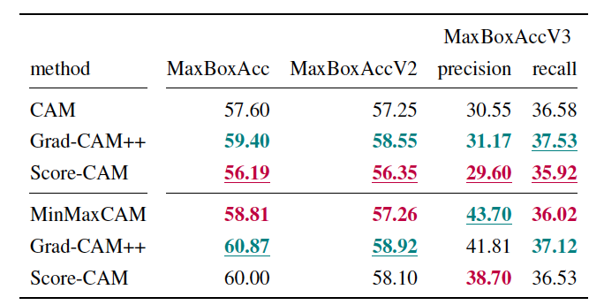
Localization: ResNet-50 - ImageNet
Notes:
Uitleggen waarom Score-CAM slechter is

Slide 21
Localization: ResNet-50 - ImageNet
Notes:
Effect regularizatie

Slide 22
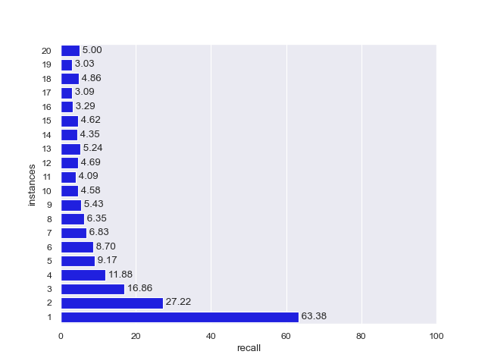
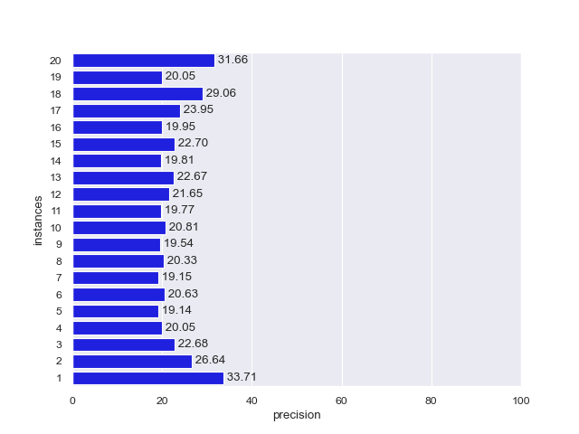
Localization: ResNet-50 - ImageNet
CAM - MaxBoxAccV3 recall: 36.58
CAM - MaxBoxAccV3 precision: 30.55
Notes:
Kort bespreken

Slide 23
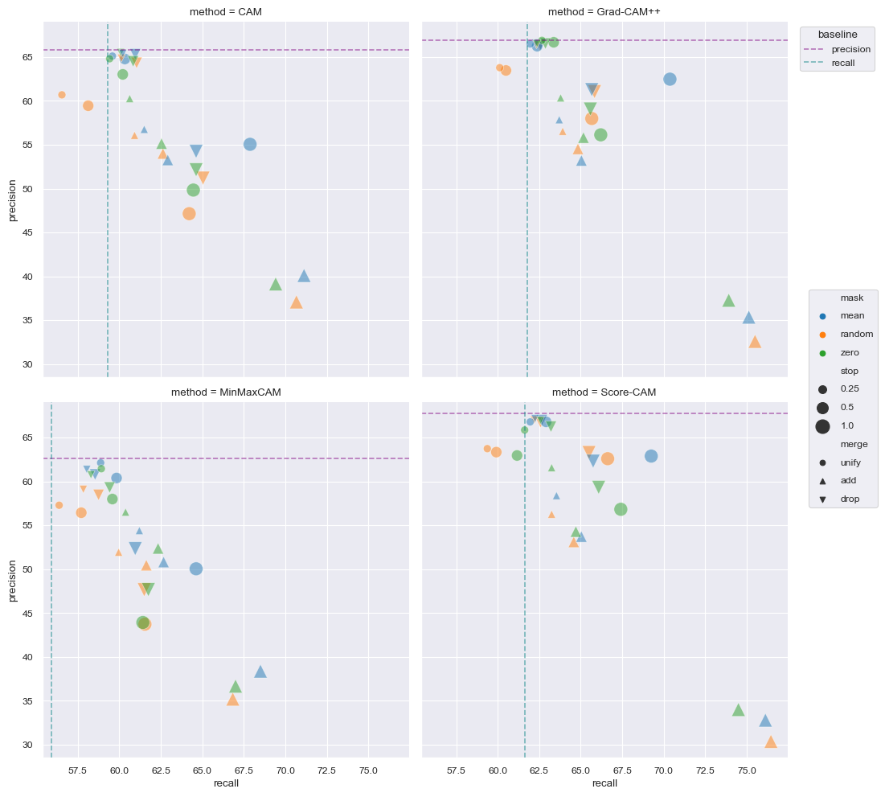
Iterative localization: ResNet-50 – Synthetic d4b
Notes:
Remark: fonts best groter (optie in seaborn: seaborn.change_context poster)

Slide 24
Iterative localization: ResNet-50 - Synthetic
TODO <images + mask for 3 iterations> for oracle and score map based.
Notes:
Qualitative examples

Slide 25
Iterative localization: ResNet-50 - ImageNet
Notes:
Remark: bigger fonts
Discuss trends:
Recall increases, precision drops
Mask strategy less important
Merge strategy important

Slide 26
Iterative localization: ResNet-50 – ImageNet
Notes:
Qualitative example
Remark:
toon enkel toevoegingen, i.p.v. stacked score map heatmaps.
In backup: meerdere images als voorbeeld

Slide 27
Conclusions

Slide 28
Conclusions

Slide 29



Slide 30
Backup

Slide 31
Learning curves
Observations
Example: MinMaxCAM for VGG16-GAP SYNTHETIC
Best localization after few training epochs
Further classification training hurts localization
Focus on most discriminative parts
In line with Choe et al, 2020b findings

Slide 32
Box Accuracy at varying CAM thresholds (IOU 50)
Notes:
BoxAcc for 1, 2, 3, 4 instance datasets
1 instance: All CAM methods perform similarly, outperformed by ScoreCAM
2,3,4: ScoreCAM performance margin over others even more pronounced
Optimal CAM threshold similar for all methods

Slide 33
Precision-Recall at varying CAM thresholds
Notes:
PR-Curves at varying CAM thresholds:
Allows us to choose preferred operating thresholds that provides the best precision-recall trade-off
1 instance: similar performance for all methods
2,3,4 instance:
ScoreCAM outperforms rest
AUC drops significantly

Slide 34
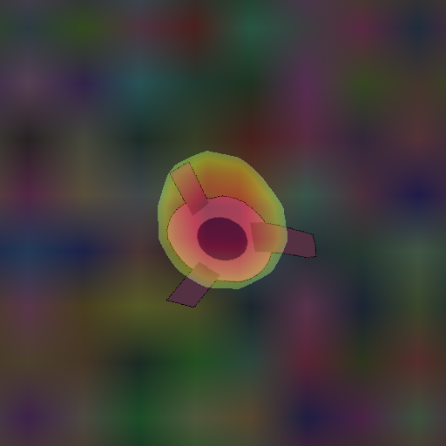
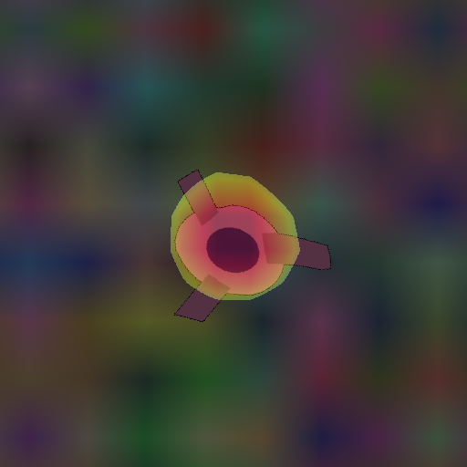
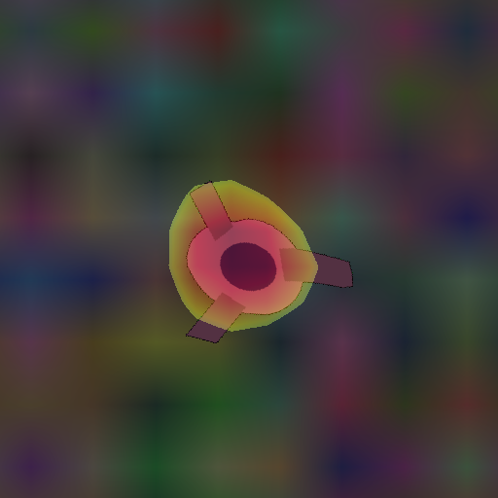
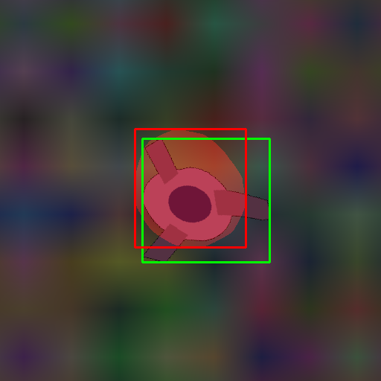
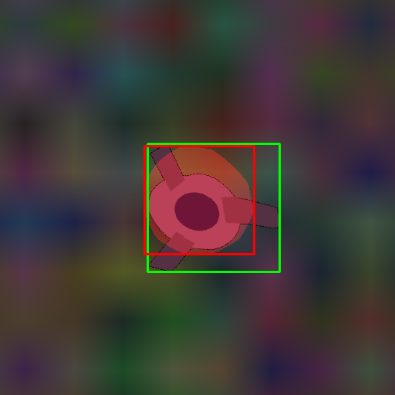
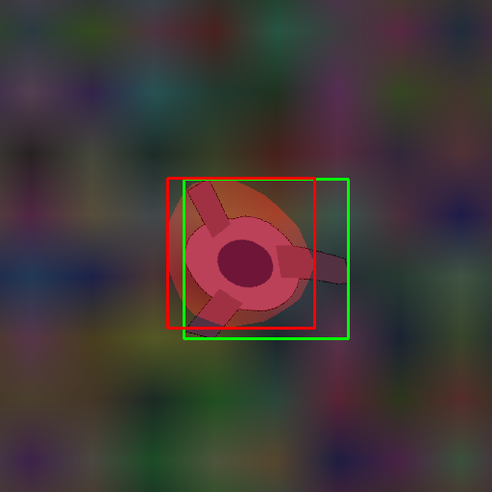
Qualitative analysis: SYNTHETIC – 1 instance
CAM (test119)
MinMaxCAM
ScoreCAM
Notes:
Single instance performance seems similar for all CAM methods
MinMaxCAM: slightly worse. May not be regularized enough.

Slide 35
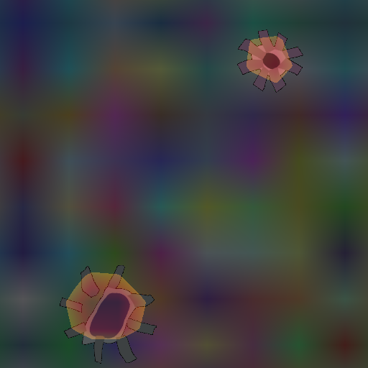
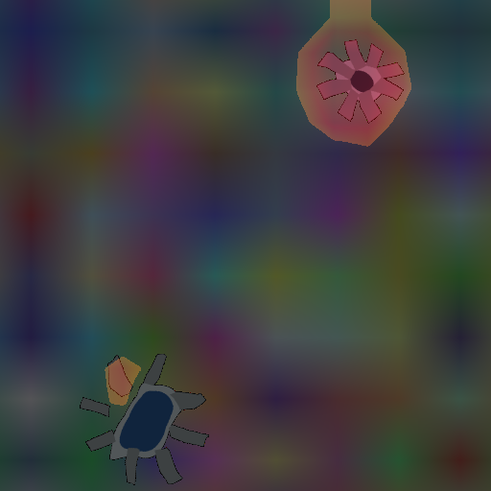
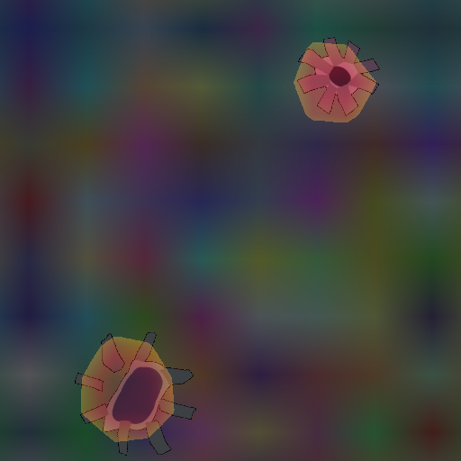
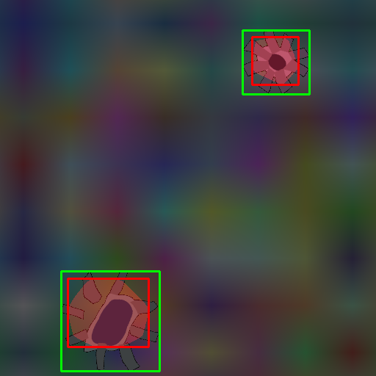
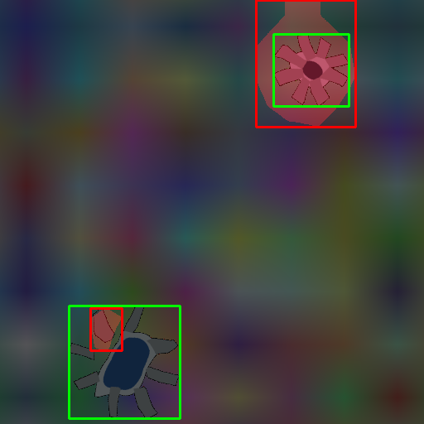
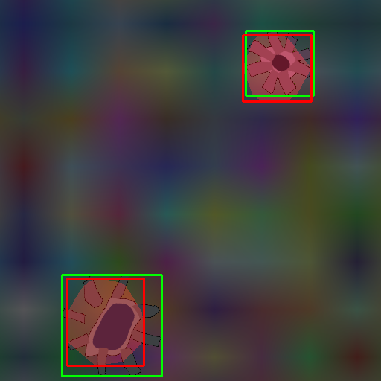
Qualitative analysis: SYNTHETIC – 2 instances
CAM (test102)
MinMaxCAM
ScoreCAM
Notes:
CAM focus on most discriminative features and underfits instances
MinMaxCAM: Overfitting 1 instance, partly fitting other instance
ScoreCAM more accurately loalizes multiple instances
A score-weighted combination of feature maps instead of a global average weighted one, seems better to solve the problem of identifying mutiple occurrences of the same class in an image..

Slide 36
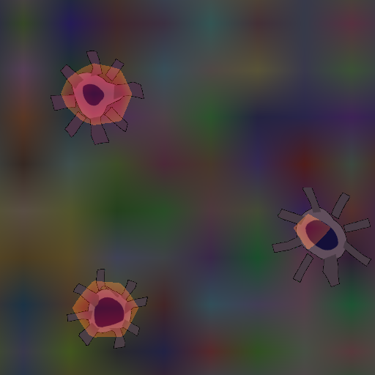
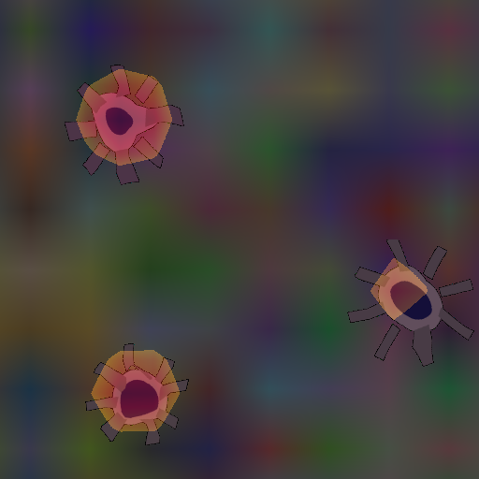
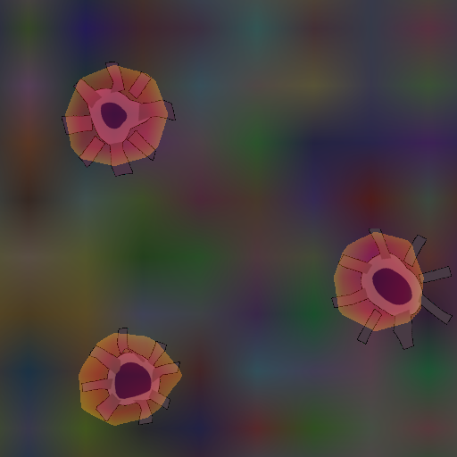
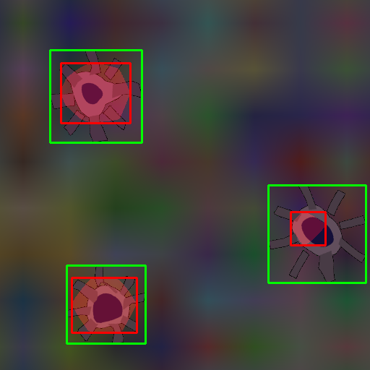
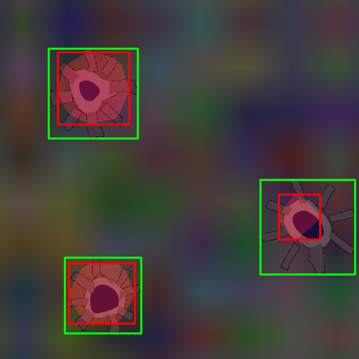
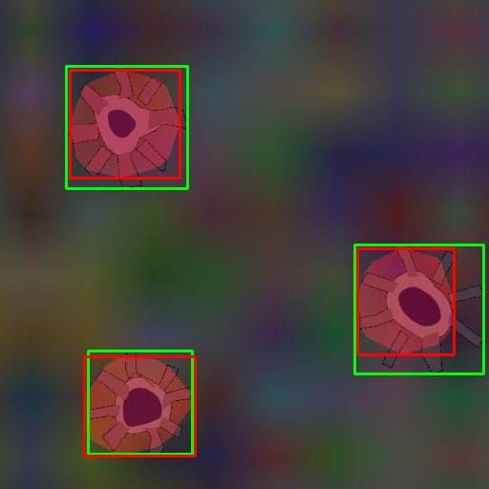
Qualitative analysis: SYNTHETIC – 3 instances
CAM (test103)
MinMaxCAM
ScoreCAM
Notes:
Same conclusions as for 2 instances.

Slide 37
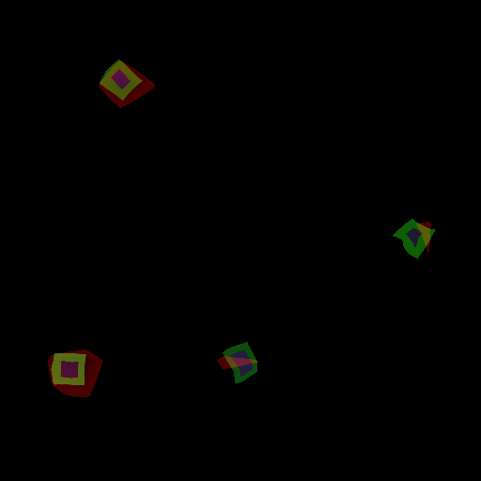
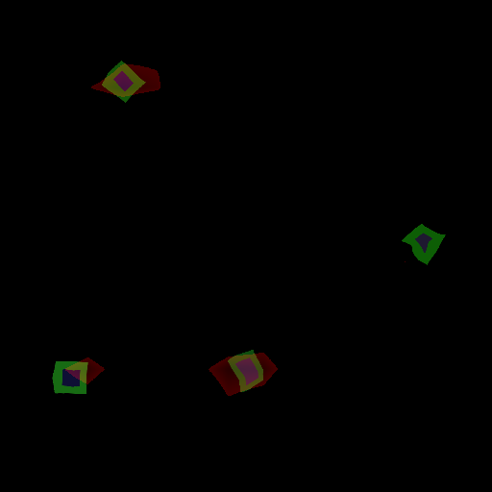
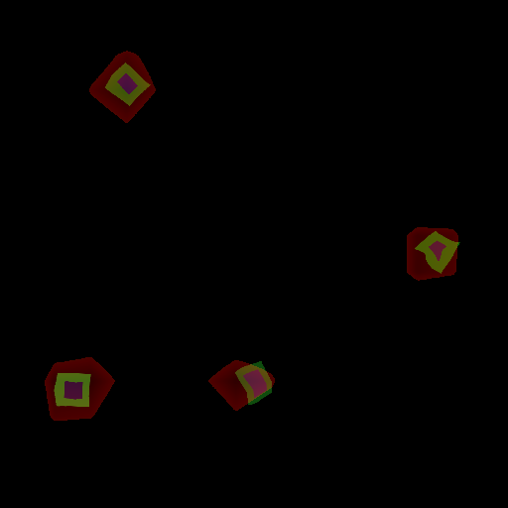
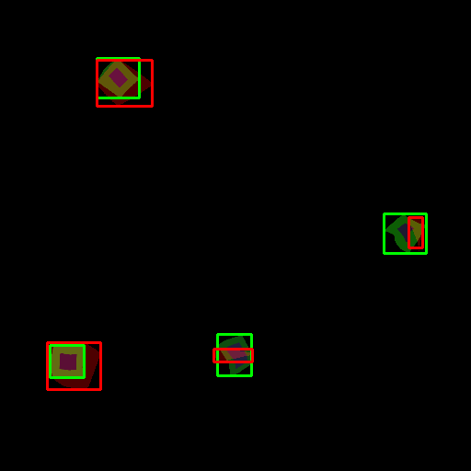
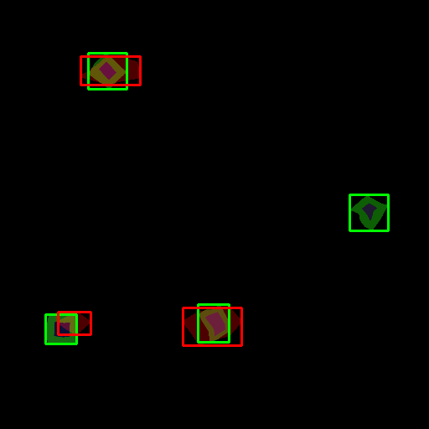
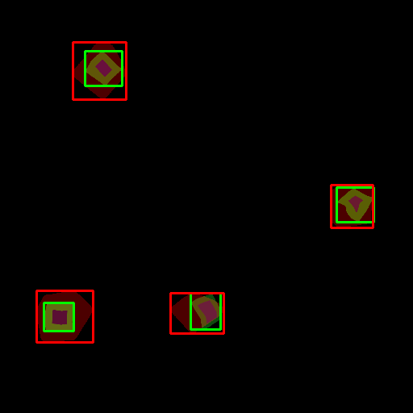
Qualitative analysis: SYNTHETIC – 4 instances
CAM (test130)
MinMaxCAM
ScoreCAM
Notes:
Smaller object instances are more challenging to localize. Easier to miss.
This example shows better-than-average performance
MinMaxCAM: more regularization may be needed
ScoreCAM: again better at capturing instances

